Slide 1
COMP 2310 Data Structures and Algorithms
Lecture 1
Introduction

Slide 2
Wisdom
Tell me and I forget.
Show me and I remember.
Let me do and I understand.
—Chinese Proverb

Slide 3
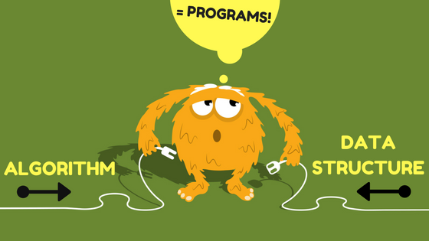
Wisdom
“Bad programmers worry about the code. Good programmers worry about data structures and their relationships.”
— Linus Torvalds, creator of Linux

Slide 4
Course Objectives
The objective of this course is to help students understand how
to structure information to support efficient data processing.
More specifically:
To study commonly used algorithms and data structures.
To introduce the idea that there are costs and benefits associated with every algorithm.
To teach how to determine the efficiency of using a data structure or algorithm.
To show how to implement common data structures and algorithms in programming languages.

Slide 5
The Need for Algorithms and Data Structures
Representing information internally is fundamental to computer science.
The main goal of most computer programs is to store and retrieve information systematically and efficiently.
For this reason, the study of data structures and
algorithms are at the heart of computer science and data processing.

Slide 6
Topics to be Covered
Topics:
Commonly used algorithms
Commonly used data structures
Simple complexity analysis
Implementation details in C++
Important:
C++ implementations aims to help learning the corresponding data structures and algorithms.
Teaching C++ is not the intended objective of this course!

Slide 7
Introduction
What is a problem?
What is an algorithm?
What is a data structure?
How to implement algorithms and data structures?

Slide 8
Problem
A problem is a mapping from an input to an output.
Examples:
Sqrt:
Sorting:
Solving an equation:
Value -> Value
Unsorted data -> Sorted data
Equation -> solution

Slide 9
Algorithms
The word algorithm comes from the name of mathematician Abu Ja’far Mohammed ibn-i Musa al Khowarizmi (In Turkish : El-Harezmi, Years : ~ 800).
A mathematician who was born in the Turkic region Uzbekistan/Khorassan and wrote in Arabic.
The word algorithm derives from his name:
Al-Khowarizmi →Algorizm→ Algorithm

Slide 10
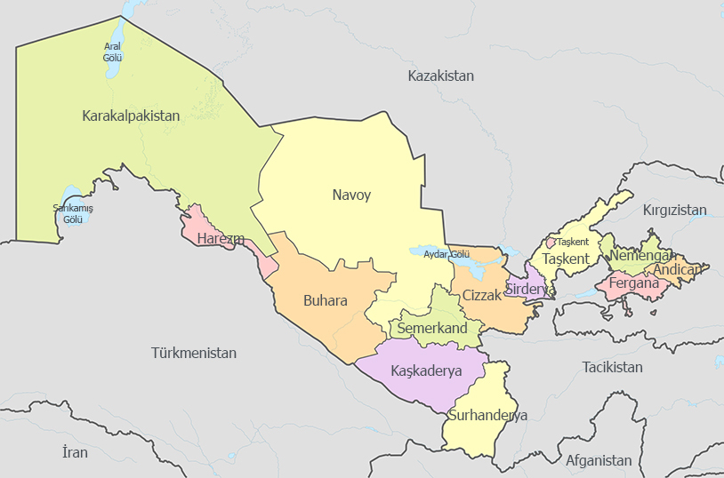
Harezm: A Province in Uzbekistan

Slide 11
Algorithms
In computer science, algorithm refers to: ”A special method usable by a computer for solving a problem”.
In general, we have the relationship:
Algorithms + Data Structures = Programs
Notes:
The statement of the problem specifies the desired input/output relationship.
If a problem can be expressed in terms of a formal model, then we can use the properties of this model to find a solution.
Once we find a suitable formal model for our problem, then we try to find a solution in terms of that model.
Our initial goal should be to find a solution in the form of an algorithm.

Slide 12
Algorithms
An algorithm consists of a finite sequence of instructions.
Example:
How to find the minimum value in a list of integers?
Solution:
Scan the list from front to end and keep track of the minimum integer found so far.

Slide 13
Algorithms
Commonly, we present algorithms using a simple language called pseudo-language.
Notes:
Pseudo-languages are a combination of the basic constructs of formal programming languages and natural language statements.
They are used to express the solution but don’t have syntax details of a programming language.

Slide 14
Algorithms
Example: Finding minimum in an integer array
Solution: A function in pseudo code :
find_min ( n:integer, a:array of integer )
{
current_min = a[1]
for i=2 to n do
if a[i] < current_min then
current_min = a[i]
return current_min
}

Slide 15
Algorithms: Desirable Properties
What are desirable properties of algorithms/Programs?
• correctness
• finite time
• modularity
• maintainability
• functionality
• user-friendliness
• extensibility
…………………..
Efficiency is a common requirement for all the properties in the list.

Slide 16
Algorithms: Reliability and Robustness
Reliability
The probability of failure-free operation of an algorithm for a specified period of time in a specified environment.
• Robustness
The degree to which an algorithm can function correctly in the presence of invalid inputs or stressful environmental conditions.

Slide 17
Algorithms: Efficiency and Complexity
Resource usage of an algorithm is important.
the time and space complexity for small inputs…
What will be the algorithm efficieny when input size grows unboundedly?
This is the problem of algorithm complexity.
Notes:
It is very important to have some idea about the resource usage of an algorithm:
In general, we are not interested in the time and space complexity for small inputs.
What will be the algorithm efficieny when input size grows unboundedly ?
This is the problem of algorithm complexity .
For a given problem, the complexity should be reduced as much as possible.
Efficiency and complexity refer to the same concept.

Slide 18
Efficieny and Complexity: Example
Two algorithms A and B that solve the same class of problems.
The time complexity of A is 5,000n, the one for B is ⎡1.1^{n}⎤ for an input with n elements.
For n = 10, A requires 50,000 steps, but B only 3, so B seems to be superior to A.
For n = 1000, however, A requires 5,000,000 steps, while B requires 2.5⋅10⁴¹ steps.

Slide 19
Why is Complexity Important?
Comparison: Time for Algorihm A : 5000n
Time for Algorithm B : ⎡1.1^{n}⎤
The number of steps
Input Size
Algorithm A
Algorithm B
n
5,000n
1.1 ^{n}
10
50,000
3
100
500,000
13,781
1,000
5,000,000
2.5*10⁴¹
1,000,000
5*10⁹
4.8*10⁴¹³⁹²
Notes:
Note that, for n=1000 Algorithm B is not feasible.
This means that algorithm B cannot be used for large inputs, while running algorithm A is still feasible.

Slide 20
Why is Complexity Important ?
With powerful computers, why program efficiency/complexity is not becoming less important?
But problem sizes and complexities are increasing too!
Notes:
With powerful computers, why program efficiency/complexity is not becoming less important?
Isn’t it possible to solve any efficiency problem that we might face by using more powerful hardware?
Improved computing power enables us to tackle more complex problems.
But problem sizes and complexities are increasing too!
We are entering BIG DATA era!

Slide 21
What is the Size of Big Data ?
Not possible to quantify:
Big data: the available computing and storage power on the market.
Example: The average commercial aircraft - like the Boeing 737 creates 20 terabytes of engine information per hour.
Remainder : Tera 10¹², Peta 10¹⁵ ,Exa : 10¹⁸, Zetta 10²¹…..
Notes:
Not possible to quantify:
“Big data” is a term relative to the available computing and storage power on the market — so in 1999, one gigabyte (1 GB) was considered big data. Today, it may consist of petabytes or exabytes of information.
Example:The average commercial aircraft - like the Boeing 737 creates 20 terabytes of engine information per hour.
→An average six-hour flight creates 240 terabytes of data.
Remainder : Tera 10¹², Peta 10¹⁵ ,Exa : 10¹⁸, Zetta 10²¹…..

Slide 22
Big Data Age!
Large datasets outgrowing the storage capacities of single physical machines .
Increased storage capacities and access speeds are needed.
Storage and analysis needs of big data
efficient algorithms/data structures are required
Notes:
Large datasets outgrowing the storage capacities of single physical machines .
-Need to partition data across a number of separate machines
Increased storage capacities and access speeds are needed.
-Still problems exist with I/O read, hardware failure, and combining data from multiple sources.
Storage and analysis needs of big data
A scalable information processing framework and efficient algorithms/data structures are required to handle vast amounts of data .

Slide 23
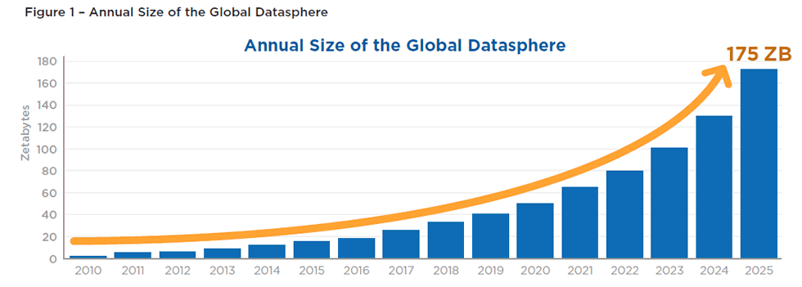
Zettabyte(ZB)= 10²¹ Bytes.

Slide 24
Data Types
At the top level, there are two data types:
System-defined data types (also called Primitive data types)
User-defined data types
Notes:
At the top level, there are two data types:
• System-defined data types (also called Primitive data types)
These are provided by programming language compiles.
• User-defined data types
If the system-defined data types are not enough, programming languages allow the users to define their own data types

Slide 25
System-defined Data Types
Data types that are defined by system are called primitive data types.
int, float, byte, char, double, bool,…
The number of bits allocated for each primitive data type depends on the language, compiler and operating system.
Notes:
Data types that are defined by system are called primitive data types.
Common primitive data types provided by many programming languages are: int, float, byte, char, double, bool,…
The number of bits allocated for each primitive data type depends on the language, compiler and operating system.
For the same primitive data type, different languages may use different sizes in byte. For example, “int” may take 2 bytes or 4 bytes.

Slide 26
User defined data types
Formed by combining many system-defined data types into a single structure.
structures, unions, enum
The system provides implementations and operations for the primitive data types.
Notes:
Formed by combining many system-defined data types into a single structure.
Examples of user defined data types are: structures, unions, enum(erated) in programming languages.
The system provides implementations and operations for the primitive data types.
For user-defined data types we also need to define operations.

Slide 27
Abstract Data Types
An abstract data type (ADT) is composed of
A collection of data
A set of operations on that data
Specifications of an ADT indicate: what the ADT operations do but not how to implement them.
Implementation of an ADT requires choosing a particular data structure.
Notes:
An abstract data type (ADT) is composed of
A collection of data
A set of operations on that data
Specifications of an ADT indicate: what the ADT operations do but not how to implement them.
Implementation of an ADT requires choosing a particular data structure.
“Abstraction allows man to see with his mind what he cannot see physically with his eyes...”

Slide 28
Data Structure
A Data structure is a particular way of storing and organizing data in computer memory so that it can be used efficiently.
A data structure is:
a collection of data values
the relationships among them
the functions that can be applied to the data.
Notes:
A Data structure is a particular way of storing and organizing data in computer memory so that it can be used efficiently.
A data structure is a collection of data values, the relationships among them, and the functions or operations that can be applied to the data.
→Data structures are specific implementations of ADTs.

Slide 29
Why do we Need Data Structures?
Suppose you wanted to write a program which uses a
certain data set.
Some Important problems:
● How would you store the data in computer’s memory?
● Would your method work for large data sets?
● Would your method allow for fast insert/delete operations?
● Would it allow for fast searching operations?
● How would you sort the data efficiently in a given order?

Slide 30
Data Structure Types
Data structures are classified into two types:
Linear data structures: Arrays, Linked Lists, Stacks and Queues.
Non – linear data structures: Trees and graphs.
Notes:
Depending on the organization of the elements, data structures are classified into two types:
Linear data structures: Elements are accessed in a sequential order but it is not compulsory to store/access all elements sequentially.
Examples: Arrays, Linked Lists, Stacks and Queues.
2) Non – linear data structures: Elements are stored/accessed in a non-linear order.
Examples: Trees and graphs.

Slide 31
Example: A simple algorithm
A is an array containing 8 numbers:
Problem : Are the values in the array sorted?
Informal algorithm :
Compare consecutive numbers until the end if there is an out of order pair return false

Slide 32
Pseudocode-1
procedure IsSorted( var A : InputArray; N : integer );
begin
for i : 1 to N - 1 do
if A[ i ] > A[ i + 1 ] then
return false;
return true;
end;

Slide 33
Pseudocode-2
//Simplified notation
IsSorted( A, N )
for i ← 1 to N - 1
if A[ i ] > A[ i + 1 ]
then return false;
return true;
Notes:
//Simplified notation, we use this notation as in Cormen et al.

Slide 34
Algorithm Complexity
Algorithms differ in efficiency.
The difficulty of algorithms for comparing their efficiencies is called computational complexity.
Computational complexity indicates how much effort is required for an algorithm or how costly it is.
An algorithm is hardly of any use if
very long time
large main memory
Notes:
Algorithms developed to solve a certain problem difffer in efficiency.
The difficulty of algorithms for comparing their efficiencies is called computational complexity.
Computational complexity indicates how much effort is required for an algorithm or how costly it is.
An algorithm that solves a problem in a very long time is hardly of any use.
An algorithm that requires extremely large main memory is also not useful in most computers.

